Slide 1
Reflections on Computer Vision Course

Slide 2
Reflections on Computer Vision Course
Computer Vision Portfolio - ITAI1378
Introduction
Module Highlights
Tools and Technologies
Machine Learning in Computer Vision
Deep Learning and CNNs
Generative AI
Autonomous Systems
Midterm and Capstone Projects
Conclusion & Future Objectives

Slide 3
Reflections on Computer Vision Course
References

Slide 4
Introduction
Course Structure: The course encompasses fundamental theories, practical applications, and advanced methodologies in computer vision.
Learning Objectives: Key objectives include mastering image processing techniques, understanding algorithms, and enhancing analytical skills.
Personal Aspirations: Motivated by real-world applications, I aim to innovate within the field of artificial intelligence.

Slide 5

Module Highlights
Foundational Principles: Module 1 encapsulated essential algorithms and techniques that underpin computer vision's operational framework.
Project Insights: A significant assignment involved developing a basic image recognition system, showcasing learned skills effectively.
GitHub Resource: Explore the GitHub repository for Module 1 projects: [GitHub Repository Link](#).
Photo by Gurkamal Teja on Pexels

Slide 6
Tools and Technologies
OpenCV Overview: OpenCV is pivotal for real-time image processing and computer vision tasks, enhancing project efficiency significantly.
TensorFlow Significance: TensorFlow facilitates robust deep learning frameworks, enabling complex model development in advanced computer vision applications.
Practical Applications: Both tools are integral for various projects including object detection, image classification, and video analysis solutions.

Slide 7
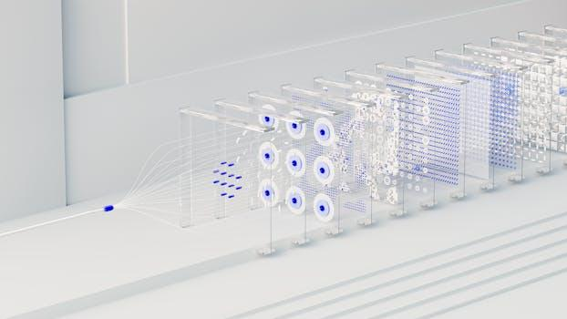
Machine Learning in Computer Vision
Key Algorithms: Explored algorithms like CNNs and SVMs, fundamental for image classification and recognition tasks in computer vision.
Real-world Applications: Case studies included autonomous vehicles and medical imaging, demonstrating machine learning's transformative impact on industries.
Model Optimization Techniques: Learned to implement techniques like transfer learning and data augmentation, crucial for enhancing model performance effectively.
Photo by Google DeepMind on Pexels

Slide 8
Deep Learning and CNNs
CNN Architecture Overview: Convolutional Neural Networks employ layers of convolutions, pooling, and fully connected networks for image analysis.
Hands-On Projects: Projects included developing CNN-based image classification models, showcasing practical applications of learned theory.
GitHub Repositories: Access relevant GitHub repositories for Module 7 projects: [GitHub Repository Link](#) for detailed exploration.

Slide 9
Generative AI
Generative AI Overview: Introduction of GANs, VAEs, and diffusion models highlights transformative potential in creative domains and industries.
GAN Applications: Generative Adversarial Networks enhance image synthesis, video generation, and unique content creation across various sectors.
VAE Significance: Variational Autoencoders aid in semi-supervised learning, facilitating representation learning for complex data distributions.

Slide 10

Autonomous Systems
Autonomous Systems Integration: Computer vision facilitates environment perception, crucial for navigation and decision-making in autonomous systems.
Key Projects Overview: Developed projects like real-time object detection and tracking, showcasing practical applications of course concepts.
GitHub Repositories Access: Access the associated GitHub repositories to explore project implementations and code details: [GitHub Repository Link](#).
Photo by Pixabay on Pexels

Slide 11

Midterm and Capstone Projects
Midterm Project Summary: The midterm focused on developing an object detection model using YOLO, achieving remarkable accuracy and efficiency.
Capstone Project Insights: The capstone involved creating a comprehensive image segmentation application, reinforcing theoretical knowledge through practical implementation.
Documentation Links: Explore detailed project documentation and code via GitHub: [GitHub Midterm Link](#), [GitHub Capstone Link](#).
Photo by cottonbro studio on Pexels

Slide 12

Conclusion & Future Objectives
Learning Journey Reflection: Throughout the course, I gained extensive knowledge in computer vision, significantly enriching my analytical and technical skills.
Major Achievements: Successful completion of complex projects highlighted my ability to apply learned concepts to real-world scenarios effectively.
Future Objectives: Aspire to further explore innovative applications in AI, driving advancements within both academia and industry.
Photo by Omar Houchaimi on Pexels

Slide 13
References
Referenced Articles and Books: Compilation of key literature and articles that informed course content, beneficial for ongoing studies.
External Resources: Curated list of websites and online materials to enhance understanding, including tutorials and educational platforms.
GitHub Repository Links: Links to the GitHub repository containing all project code and supplementary resources for deeper exploration.

